Slide 1
Streaming Manager Developers API Workshop
George Owen – IBM Cloud

Slide 2
Agenda
Review Workshop Objectives
Review Streaming Manager API
Authentication Models
Solution Overview
Technology Code Review
Debugging Overview
Retrieving Channel and Video Collections
Lab 1: Displaying Streaming Manager Account Content
Embedding the Player
Managing Player Content
Retrieving Data from Player
Lab 2: Embedding Player with Controls

Slide 3
More Agenda
Creating Channels
Lab 3: Channel Create
File Upload to Channel
Lab 4: Channel Upload
Changing Accounts
Lab 5: OAuth Account Change

Slide 4
Workshop Overview
Review Workshop Objectives
Review Streaming Manager API

Slide 5
Objectives
The IBM Cloud Video product offers an extensive set of capabilities for producing, managing and showing video content
The product also provides various APIs that allow access to those capabilities from a custom application or web page
This workshop will provide hands-on experience with subset of those capabilities, including
Access an IBM Cloud Video account and retrieve channel and video lists
Extract attributes from channel and video objects
Embed the IBM Cloud Video Player to show channel or video content
Load the Player frame with new content
Control the Player: play, stop, pause
Show current content attributes like duration and progress
Upload videos to channel and create a new channel

Slide 6
Workshop Environment
The workshop will be hosted on Bluemix
This is for convenience and has no connection to any Bluemix Ustream template
This will require specific local resources
A Bluemix trial account
Cloud Foundry toolkit
Eclipse Neon IDE
Git
Eclipse is optional, but it does provide an integrated view of the test application files and built-in editors

Slide 7
API Review
Review Workshop Objectives
Review Streaming Manager API
Authentication Models

Slide 8
Channel API
The Channel API provides a large set of functions for managing channels and videos
(Functions covered in the workshop are in bold)
List a user’s channels Retrieve channel details Title Owner Description Status Viewing statistics Edit channel details List channel videos List channel scheduled events Create hooks for channel events Create and delete channels OAuth security options | Branding and logo management Update channel background Manage user access and roles Manage streaming quality Operations to adjust recordings Retrieve video details Title Description Length Number of views Edit video details Download, upload and delete videos Manage video expiration

Slide 9
Player API
The Player API provides a set of functions for embedding and managing a content Player
Embed a Player for channel or video content Load new content into Player instance Play, pause and stop current content Seek specific position in video Set Player quality Retrieve Player properties for current video Duration Progress Number of viewers Content ID | Create listener functions to trap events Channel goes live Channel goes offline Video finishes Video is now playing Video size Video quality Content (if it changed)

Slide 10
Authentication
(the complicated part)
Review Streaming Manager API
Authentication Models
Solution Overview

Slide 11
Authentication Models for Secure Access
The Streaming Manager APIs have 3 security flow models for accessing content
Client credentials
Used for server-side applications to manage content, fixed access token is generated in a Streaming Manager account
Implicit
Used for standalone, native clients (desktop / mobile). The user enters credentials to a secure login webpage. After logging in the browser is redirected to a special URL (defined by the client), passing the access token in the URL.
Authorization code
Useful for third-party sites with a server and client components
The user enters credentials on a secure login webpage. After logging in the browser is redirected to a special URL (defined by the client), passing an authorization code in the URL. The third-party server obtains the access token with another HTTP request in the background using the authorization code. This method is more secure than the implicit flow if the third-party client has a client+server model.

Slide 12
Authentication Mechanics
Streaming Manager provides two OAuth2 authentication URLs
https://www.ustream.tv/oauth2/token
This URL returns an access token for calling the APIs
Used directly by the Client Credentials flow with the client’s key as input
https://www.ustream.tv/oauth2/authorize
The Authorization flow must first call this URL to acquire an authorization token that is used when calling for an access token
It prompts with a new page where Streaming Manager credentials are entered
A HTTP redirect is made to a URL specified by the client with a token included
For Authorization flows the token is the step 1 authorization token
For Implicit flows the token is the actual access token

Slide 13
Access Tokens
There are two types of access tokens
Bearer: used only on encrypted channels
MAC: used on unencrypted channels, and required if client is using the Streaming Manager Broadcasting Library
The authorization endpoint will provide whichever token type is requested
Access tokens expire after 1 day by default, except the authorization endpoint has scope parameter to provide altered tokens:
Offline: this token never expires
Broadcast: only for MAC tokens, used with Broadcasting Library

Slide 14
Authorization Request Endpoint Details
The authorization endpoint accepts the OAuth2 standard parameters plus a set of Streaming Manager -specific parameters
OAuth2 standard:
response_type: “code” for authorization flow, “token” for implicit flow
client_id: 40-character hash code, provided by Streaming Manager
redirect_uri: URI redirect target after successful authentication
state: optional string for comparison to prevent XSRF attacks
scope: optional, either “offline” for Offline, “broadcaster” for Broadcast
Streaming Manager-specific, all optional
token_type: “bearer” or “mac”
device_name: full name of device or application, shown on token list on Streaming Manager website
display: “touch” creates a mobile-optimized version
lang: show the authorization page in this locale

Slide 15
Authorization Endpoint Responses
When response_type = “code”
code: the 40-character authorization code
state: the original “state” parameter returned
When response_type = “token” and token_type = “bearer” (or is not set)
access_token: the 40-character access token
expires_in: current token lifetime in seconds
token_type: “bearer”
state: the original “state” parameter returned
When response_type = “token” and token_type = “mac”
access_token: the 40-character access token
expires_in: current token lifetime in seconds
mac_key: the 40-character MAC secret
created_at: UTC timestamp of token creation
mac_algorithm: “hmac-sha-1”
token_type: “mac”
state: the original “state” parameter returned

Slide 16
Token Endpoint Details
The token endpoint has different sets of parameters depending on the authorization flow used
Authorization Flow
grant_type: “authorization_code”
client_id: 40-character hash code, provided by Streaming Manager
code: authorization code received from authorization endpoint
redirect_uri: redirection URI used in the call to the authorization endpoint
Authorization header: “Basic” + client id
Client Credentials
grant_type: “client_credentials”
client_id: 40-character hash code, provided by Streaming Manager
device_name: optional device/application name
token_type: optional, “bearer” or “mac”
scope: optional, “offline” or “broadcaster”
Authorization header: “Basic” + client id

Slide 17
Token Endpoint Responses
Calls to the Token endpoint, and to the Authorization endpoint with the “token” response type, return a variable set of attributes
access_token: the 40-characters access token for use in the channel APIs
expires_in: optional, only if Offline scope not enabled
token_type: “bearer” or “mac”, depending on the request
state (optional): the “state” value used in the request
mac_key (optional): the “mac_key” value used in the request
mac_algorithm (optional): the “mac_algorithm” value used in the request
created_at (optional): the “created_at” value used in the request

Slide 18
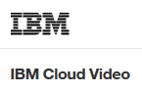
Authorization Flows Illustrated
The three flow types look like this
Authorization endpoint
Token endpoint
Login with IBM Cloud Video name and password
2. Redirect to call
token endpoint
2. Return access token
1. Call auth endpoint
1. Call auth endpoint
3. Return access token
1. Call token endpoint
2. Return access token
Implicit flow
Authorization flow
Client Credentials flow

Slide 19
Solution Review
(the end of the tunnel)
Authentication Models
Solution Overview
Technology Code Review

Slide 20
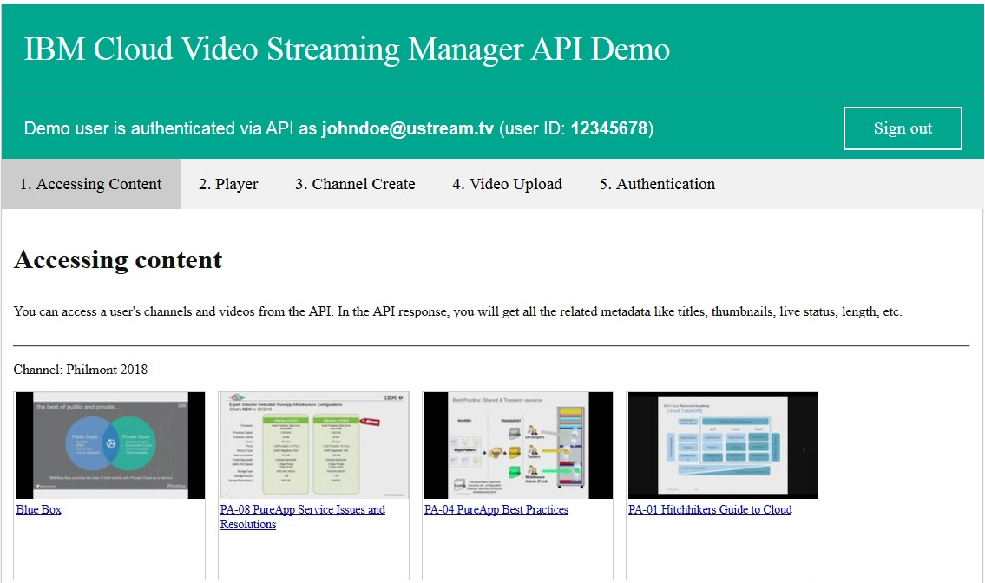
Solution Tab 1
The working version of the application will present 5 tabs on a web page with each tab demonstrating one function of the API
User information
Groupings of channels with associated videos

Slide 21
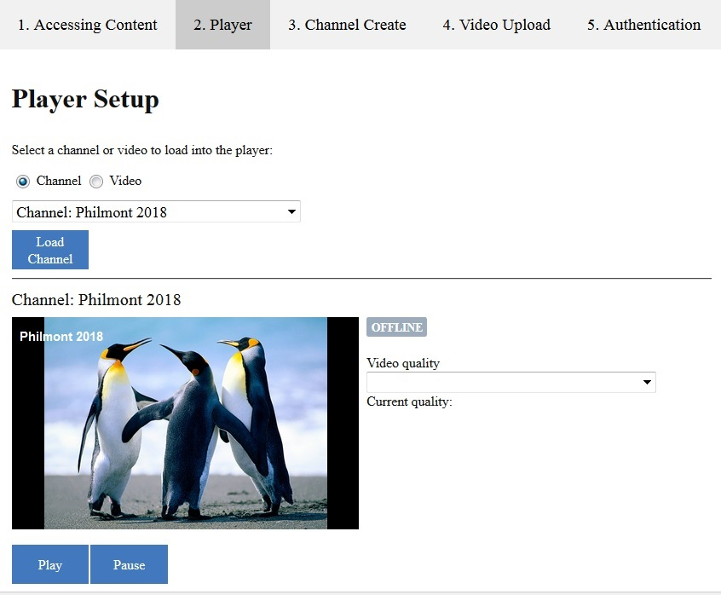
Solution Tab 2 - Channels
The 2nd tab displays the embedded player with its associated controls
Dynamic selection field and button based on content type
Status indicator
Quality controls
Player controls

Slide 22
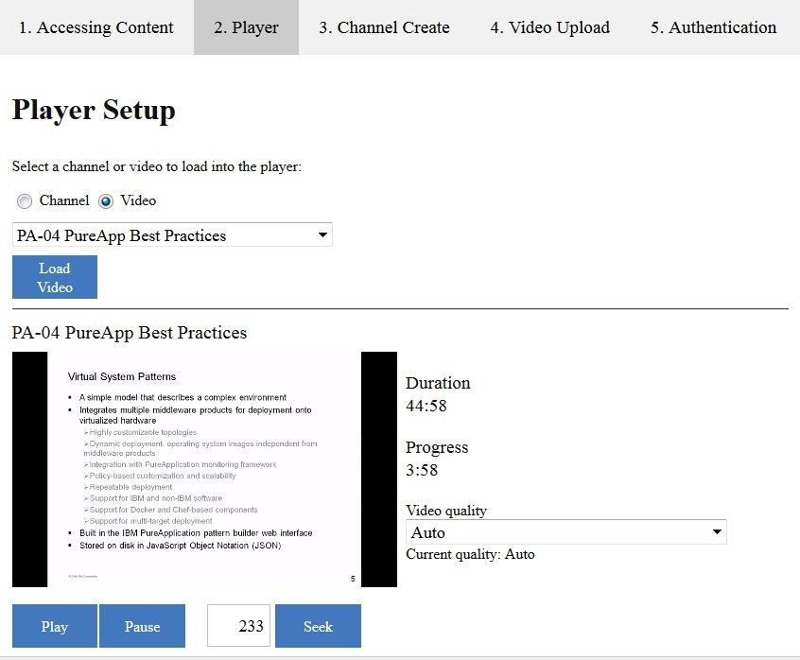
Solution Tab 2 - Videos
The 2nd tab displays the embedded player with its associated controls
Dynamic selection field and button based on content type
Duration and progress indicators
Quality controls
Player controls

Slide 23
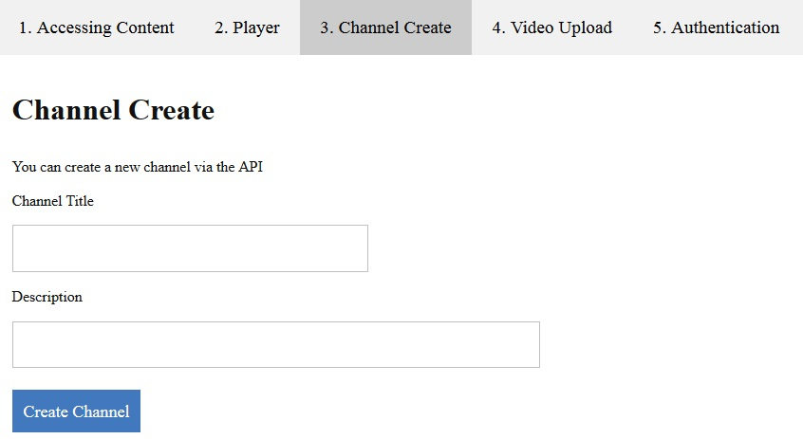
Solution Tab 3 – Channel Create
New channels can be created with a title and description
Title and description
Create control

Slide 24
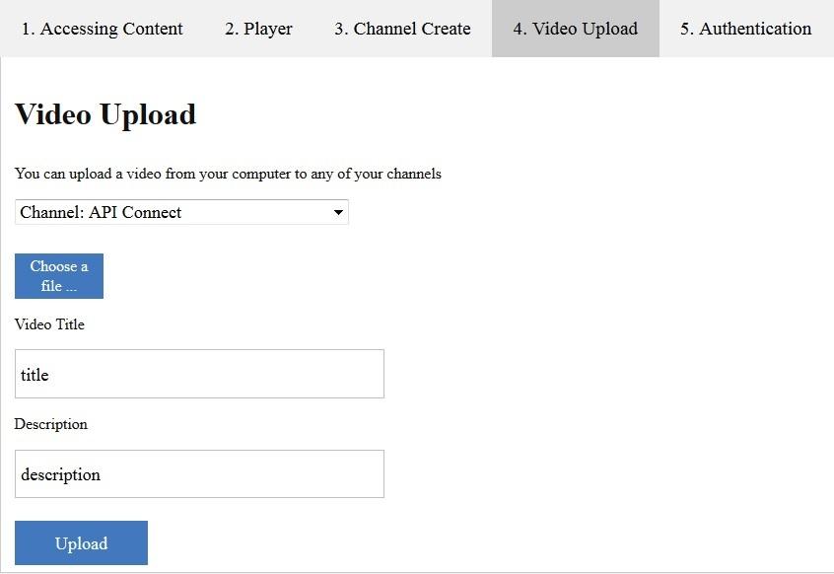
Solution Tab 4 – Videos Uploaded to Channel
After selecting a channel videos can be uploaded
Select the channel
Browse for file(s)
Title and description
Upload control

Slide 25
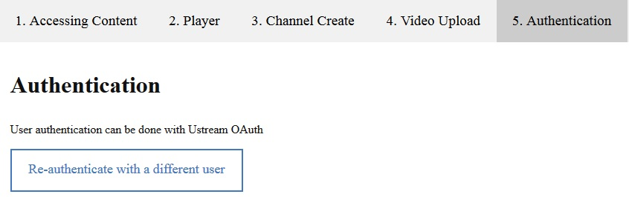
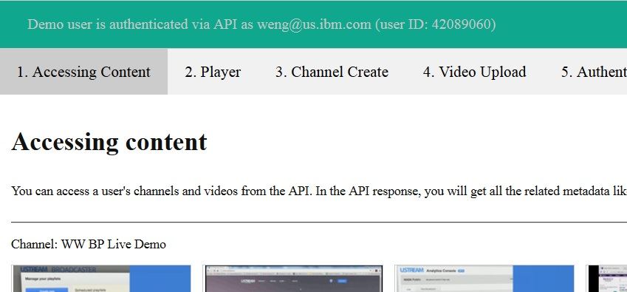
Solution Tab 5 – Re-Authentication
The last tab allows the user to authenticate with their own id
Updated account information
Authenticate with identity provider
New channel and video content

Slide 26
Technology Code Review
(HTML, CSS, PHP and Javascript: the informative section)
Solution Overview
Technology Code Review
Debugging Overview

Slide 27
What’s in the workshop
This section will briefly review code samples for the various languages used in the workshop
The Channel and Player APIs provides access to account content, and then the output must be managed and formatted for useful user experience
First let’s look at the default HTML

Slide 28
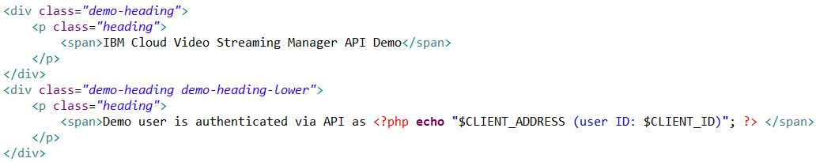
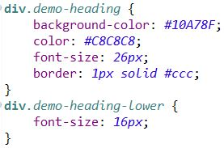
HTML – Home Page Headings
The default web page provides a tabbed structure that will contain the various API functions
The header content is defined in 2 <DIV> blocks
CSS settings control the appearance of the 2 sections and the font sizes
Inline PHP code dynamically loads the account’s email address and id
Both sections have the same visual design
The lower section uses a smaller font

Slide 29
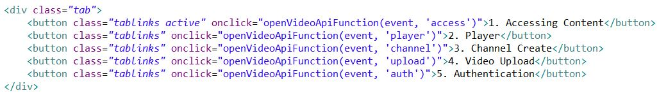
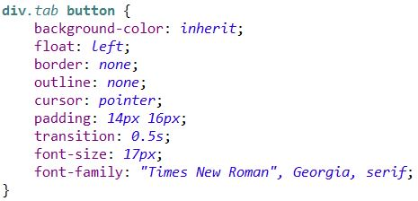
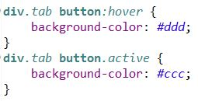
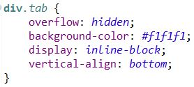
HTML – Home Page Tabs appearance
The tab structure is in two parts, the tabs themselves and the content blocks for each tab
Two CSS classes define the appearance of the tabs, which are actually buttons with special formatting
Determines how the tab buttons will look
Changes the tab color when the tab is used
Determines how the tab buttons are organized on the page
Notes:
s

Slide 30
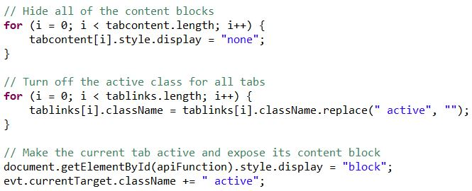
HTML – Home Page Tabs programming
Each tab button also calls a Javascript function when it’s activated
This code determines what content is exposed
Hide all of the tab content blocks
Make all of the tabs inactive
Expose the current tab’s content and make it the active tab

Slide 31
PHP – Overview
PHP code runs on the server and has a wide variety of capabilities
Generate dynamic page content
Create, open, read, write, delete, and close files on the server
Collect form data
Send and receive cookies
Add, delete, modify data in your database
Control user-access
Encrypt data
This workshop will use it to generate page content, collect form data and store application data in a local session environment

Slide 32
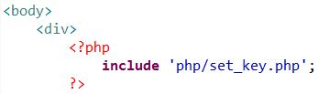
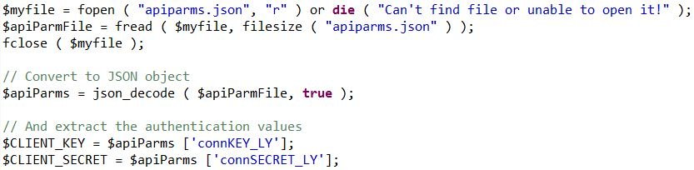
PHP - Setup
The home tab has PHP code embedded that gathers the default account access and saves it for subsequent script invocations
Output from a PHP script will be displayed where the script is located in the HTML
This initial script doesn’t have any output, it does the initial login and saves the access token
Running on the server, it has access to any file packaged with the project, or on the server itself
Open the local project file
Pull out the account’s API key and secret

Slide 33
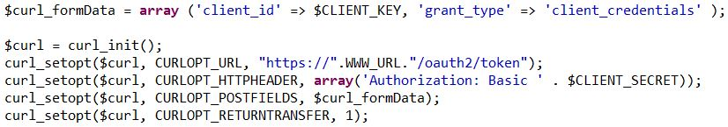
PHP – Setup for API Calls
After retrieving the API keys the script can login to Streaming Manager and save the access token for subsequent API calls
Login with account’s API keys
Retrieve token from response, save for later scripts

Slide 34
PHP – Generate Content
The first tab lists channel and video content
PHP code will retrieve that data from the Channel API and build the web page
For each video build a new <DIV> block with a thumbnail and hyperlink to the recorded video
Start building a channel <DIV> block with channel data returned by the API

Slide 35
Debugging
(the helpful section)
Technology Code Review
Debugging Overview
Retrieving Channel and Video Collections

Slide 36
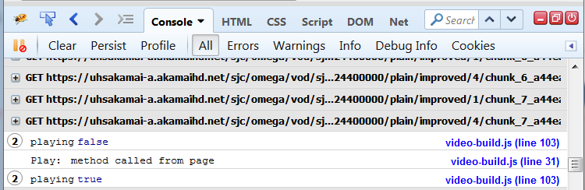
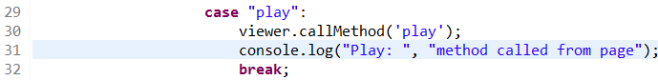
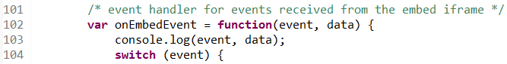
Debugging HTML and JavaScript
Debugging can be a challenge for web applications. This application has both server and client code which introduces an additional challenge.
For JavaScript there are browser tools available that can assist, FireBug for Firefox being one
For example, this tool can display console output from a script

Slide 37
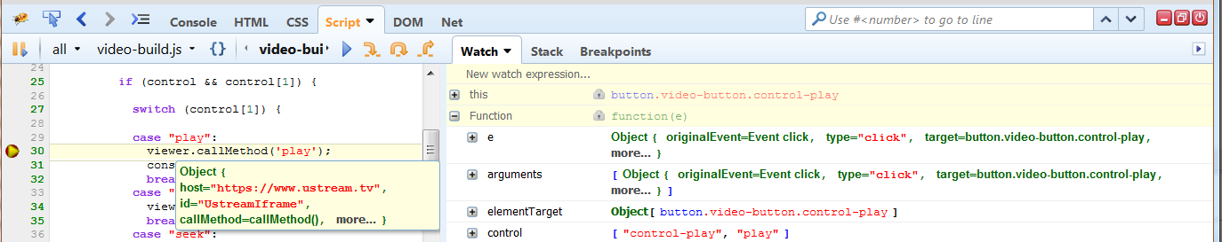
Debugging – Javascript Breakpoints
The tool also allows breakpoints to be set so the code can be inspected as it executes
Click to set breakpoint
Resume
Step to Next
Elements
Hover over variable to show properties

Slide 38
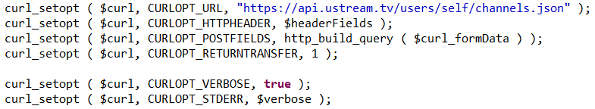
Debugging – PHP on the Server
Debugging the PHP scripts is more of a challenge because the code is running on the web server
The PHP curl library provides some options to assist with requests
Script code included directly on the page can issue ‘echo’ to output variables to the page
Script code running outside the main page has it’s own HTML environment
First, additional request parameters can be added to the HTTP requests

Slide 39
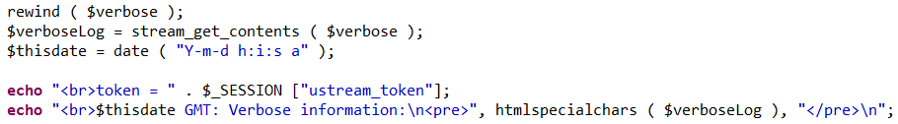
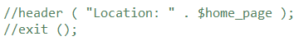
Debugging – Show PHP Results
A temporary debug file is first opened for capturing the debug output
And then the output is echoed back to the screen and no location switch is done
For functions like the file upload and channel create, the output will be in its own web page, otherwise it will show on the home page where the PHP code is placed
See file Lab Solutions/Lab 1/channel-create-debug.php for complete example

Slide 40
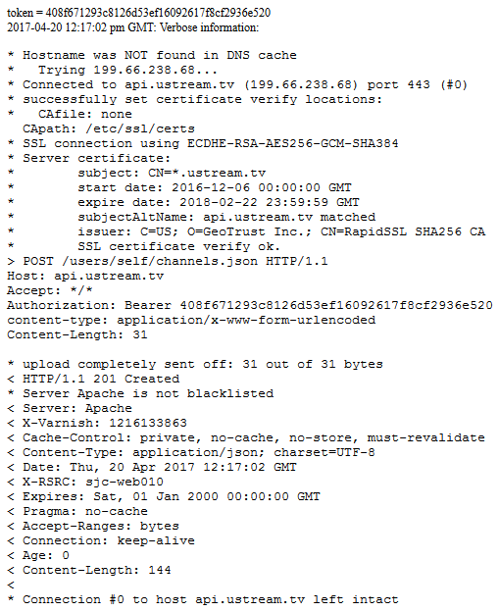
Debugging – PHP Output
1
Here is an example of a channel create request
Access token from session
Verbose request output
Request type and URI
Request host
Token in request header
Response code
Total content length
2
3
4
5
6
7

Slide 41
Debugging – PHP Script Failures
It’s possible the PHP code fails catastrophically
Refer to PHP server logs
Bluemix implementation has command to show server logs
Here, the script name was actually wrong on the web page
If there is no output from the script, check the server logs
>cf logs ustream-workshop-lab1-owenge
Connected, tailing logs for app ustream-workshop-lab1-owenge in org rtk@us.ibm.com / space dev as rtk@us.ibm.com...
2017-04-19T16:26:24.36-0400 [APP/0] OUT 20:26:24 httpd | [Wed Apr 19 20:26:24.323351 2017] [proxy_fcgi:error] [pid 50:tid 139655148168960] [client 169.45.162.88:58716] AH01071: Got error 'PHP message: PHP Notice: Undefined index: my_file in /home/vcap/app/htdocs/php/file-upload.php on line 33\n', referer: https://ustream-workshop-lab1-owenge.mybluemix.net/
Failing script reference

Slide 42
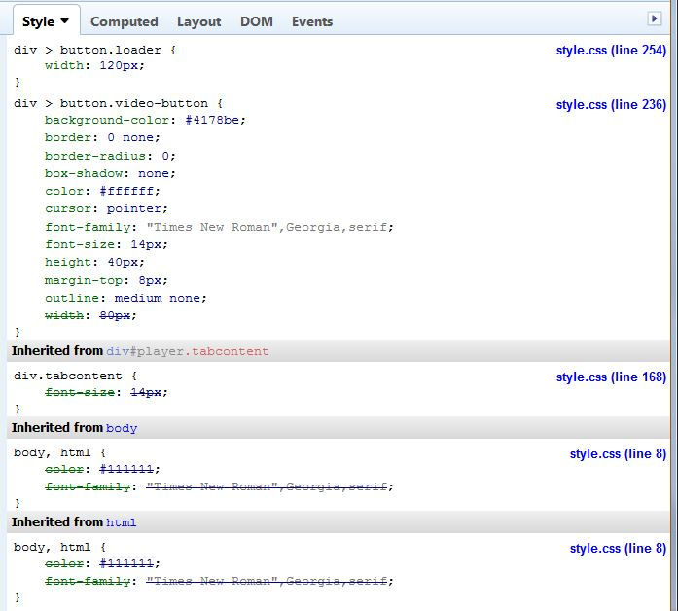
Debugging - CSS
Styling HTML elements can be complex and obscure
Similar HTML tags with different formatting requirements leads to CSS inheritance and cascading
The Firebug tool can show which CSS definitions apply to an HTML element
Hierarchy is from child to parent definitions
Parent attributes superseded by child attributes shown with strikethrough
Shows all definitions that are relevant

Slide 43
Code Review:
Retrieving Channel and Video Data
Debugging Overview
Retrieving Channel and Video Collections
Lab 1: Displaying Streaming Manager Account Content

Slide 44
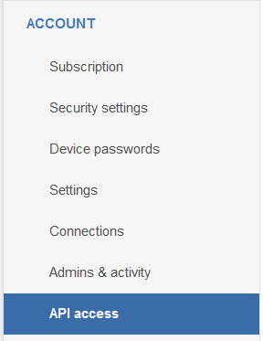
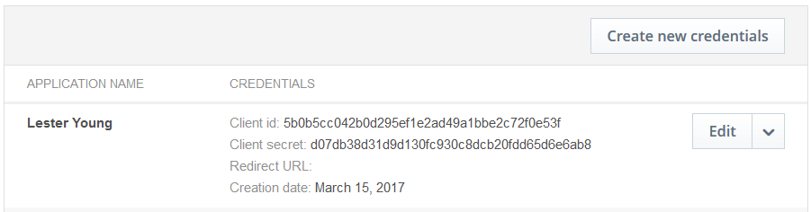
Channel API – Retrieving Content: Identity
Retrieving content is a 2-step process
Acquire identity
Acquire access token
Call channel and video APIs (step 4)
The first 4 labs will use the Client Credentials authorization flow (it’s the easiest)
Identity is defined in the Ustream account to satisfy Step 1
CLIENT_KEY
CLIENT_SECRET

Slide 45
Channel API – Retrieving Access Token (Step 2)
Implementation details depend on personal preference and skills
The first two labs use PHP to provide server-side operations and JavaScript to perform client-side operations
Using the provided client key and client secret, here is the code to acquire an access token
Specify the client key in a Form data array
$curl_formData = array ('client_id' => CLIENT_KEY,
'grant_type' => 'client_credentials'
);
$curl = curl_init();
curl_setopt($curl, CURLOPT_URL, "https://www.ustream.tv/oauth2/token");
curl_setopt($curl, CURLOPT_HTTPHEADER, array('Authorization: Basic ' . CLIENT_SECRET));
curl_setopt($curl, CURLOPT_POSTFIELDS, $curl_formData);
curl_setopt($curl, CURLOPT_RETURNTRANSFER, 1);
$result = curl_exec($curl);
Set URL to token generator
PHP curl makes call
Set client secret in authorization header

Slide 46
Channel API – Retrieving Channels (Step 3)
With the access token in hand the channel and video information can be retrieved
The Channel URL is a common one, the token determines which account is accessed
Retrieving channels is straightforward
Set channel URL
$curl = curl_init();
curl_setopt($curl, CURLOPT_URL, "https://api.ustream.tv/users/self/channels.json");
curl_setopt($curl, CURLOPT_RETURNTRANSFER, true);
curl_setopt($curl, CURLOPT_HTTPHEADER, array('Authorization: Bearer ' . $auth_token,
'content-type: application/x-www-form-urlencoded'));
$result = curl_exec($curl);
Access token from first step

Slide 47
Channel API – Retrieving Videos (Step 4)
The Video URL is derived from the Channel URL with the id of the target channel
Retrieving videos is similar but includes a filter to restrict which videos are returned
Create filtering parameter
$curl = curl_init();
$fields = array('filter' => array('protect' => 'private,public'));
$field_query = http_build_query($fields);
curl_setopt($curl, CURLOPT_URL, "https://api.ustream.tv/channels/$channel_id/videos.json/?$field_query");
curl_setopt($curl, CURLOPT_HTTPHEADER, array('Authorization: Bearer ' . $auth_token,
'content-type: application/x-www-form-urlencoded'));
curl_setopt($curl, CURLOPT_RETURNTRANSFER, true);
$result = curl_exec($curl);
Set video URL
Access token from first step

Slide 48
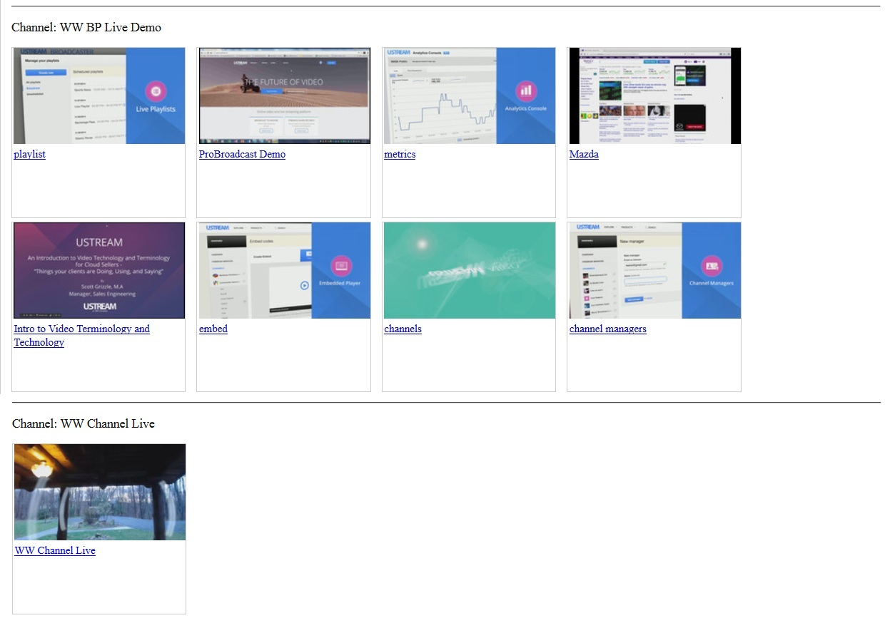
Lab Overview
Lab 1:
Contact the Streaming Manager token generator for an access token
Retrieve the account’s channels and all non-private videos
Create entry blocks for each video, organized by channel, with thumbnails and hyperlinks to the video
First channel and videos
Retrieving Channel and Video Collections
Lab 1: Displaying Channels and Videos
Embedding the Player
First channel and videos

Slide 49
Code Review:
Embedding the Player
Debugging Overview
Embedding the Player
Lab 2: Embedding Player with Controls

Slide 50
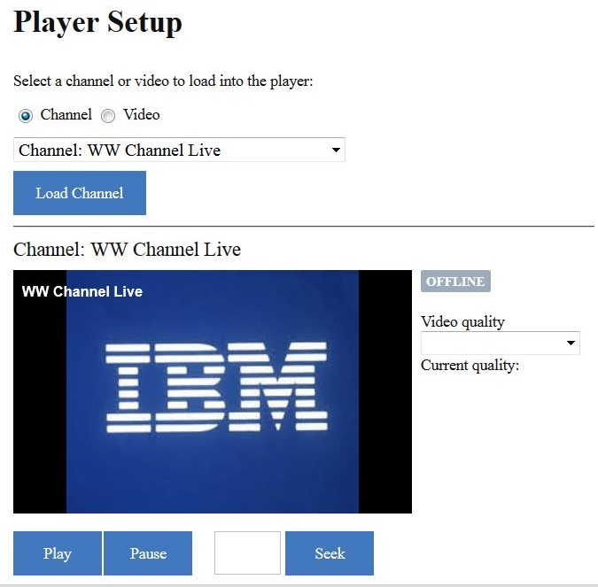
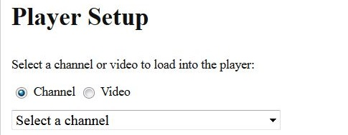
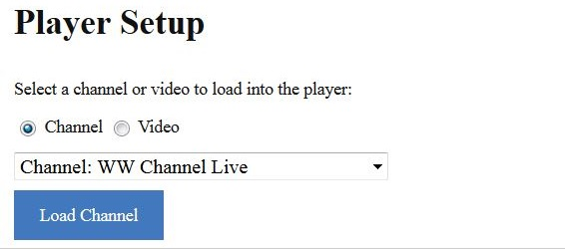
Player Loading – Web Page Behavior
Clicking the load button will expose the player with different status fields for channel or video
The player web page will expose sections in sequence
Different content will be exposed depending on selections that are made
First select channel or video
A selection will expose the respective button

Slide 51
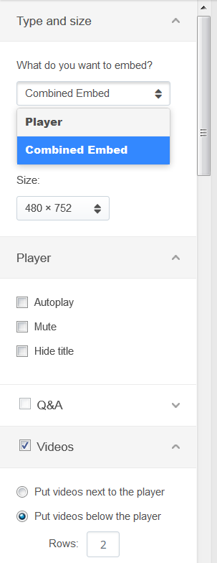
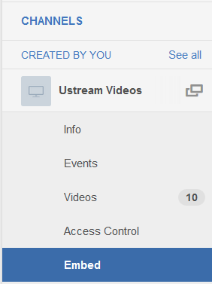
Specifying Player Embed URL Options
Embedding the video Player starts with the generation of a URL from the IBM Cloud Video account page
There are two styles, one with only a pane for the content, and one that includes the video gallery of a channel
Modify the characteristics in each section

Slide 52
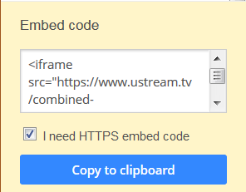
Generating Player Embed URL
Below the Player options is the HTML source of the Player URL
The HTML text will reflect the options selected above
<iframe src="https://www.ustream.tv/
combined-embed/
22952334?
social=0&
videos=tab&
html5ui&
autoplay=true
&showtitle=false"
style="border: 0 none transparent;"
webkitallowfullscreen
allowfullscreen
frameborder="no"
width="800"
height="270">
</iframe>
<iframe src="https://www.ustream.tv/
combined-embed/
22952334?
social=0&
videos=gallery&
videosCount=6&
html5ui"
style="border: 0 none transparent;"
webkitallowfullscreen
allowfullscreen
frameborder="no"
width="480"
height="752">
</iframe>

Slide 53
Adding Embed Code to HTML
The generated HTML string can be added to a web page
In this example, an “id” attribute has been added so that the Player can be controlled with channel API calls
Also, it uses the basic Player format, so some of the options seen in the examples on the previous slide are not included
Code reference
Notes:
Take note of the “id” value. This value will be referenced by the code that implements the player controls.

Slide 54
Let’s Play Video
Debugging Overview
Embedding the Player
Lab 2: Embedding Player with Controls

Slide 55
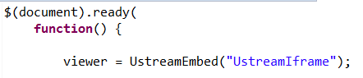
Managing the Player with Controls
Managing the Player content involves a number of HTML components
A special viewer object created from the Player iFrame
Event handlers for button click events
Event handlers for the various events initiated by the Player
This part of the solution is developed in JavaScript, residing in a function that is loaded at document.ready time (when the HTML DOM object is ready for interaction)
The first step is to create a JavaScript object using the IBM Cloud Video-supplied library function
The ‘viewer’ variable will be used for all interactions with the Player

Slide 56
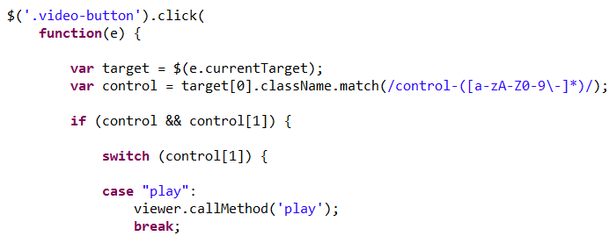
Setting up the Player Control Buttons
How this is implemented is personal choice
This solution assigns specific HTML classes to the button objects
To start, all “video-button” class objects can be trapped for clicks
Then the “control-*” classes can be used to correlate a button with a Player operation
Play button example

Slide 57
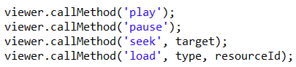
Player Operations
Player operations have a simple interface: “viewer.callMethod(‘play’)”
The workshop solution will implement 4 basic operations
The first two are self-explanatory
The ‘seek’ operation takes the number of seconds into the video as an argument
The ‘load’ operation takes a type, like ‘channel’ or ‘video’, and that resource’s id

Slide 58
Extracting Player Properties
Debugging Overview
Embedding the Player
Lab 2: Embedding Player with Controls

Slide 59
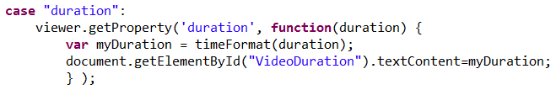
Retrieving Current Player Properties
The Player returns a small set of properties for the current content
Duration
Progress
Viewers
Content ID
Properties can be explicitly retrieved or discovered in an event listener
A function parameter is inserted into the method call to handle the response

Slide 60
Listening for Player Changes
Debugging Overview
Embedding the Player
Lab 2: Embedding Player with Controls

Slide 61
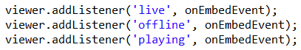
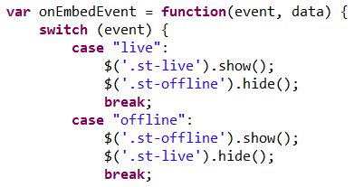
Asynchronous Player Events
The Player will issue various events that can be trapped to display the current status
As with the functional operations, listener routines need to be defined
The possible events
ready, quality, live, offline, playing, finished, size, content
The listener function includes a response for each implemented event
Button class referenced by listener code to change the button’s visibility

Slide 62
Asynchronous Events with Data
Some events provide data with the trigger
The data can be used to display characteristics of the current content
The “quality” event can be called frequently as network conditions change, sending a set of objects with these attributes:
id=0
active=true
bitrate=548
label="500kbps“ – this value is always an even number rounded from the actual bitrate
The “content” event identifies the type and id of currently loaded content
“channel” or “recorded”
content id
The “size” event returns the dimensions of the embedded Player iframe
“width” in pixels
“height” in pixels
The “duration” event returns the video’s duration
“duration” in seconds

Slide 63
Lab Overview
Lab 2:
Create 2 selection fields for choosing a specific channel or video
Create 2 load buttons for the corresponding selection fields
Create management buttons that will Play and Pause the current video
Create a Seek button that will go to a specific location in the current video
Display the current video status, such as Playing, Offline and Ended
Display the current quality settings for this connection
Display a video’s duration and running progress indicator
Embedding the Player
Lab 2: Embedding Player with Controls
Creating Channels

Slide 64
Creating Channels
(the easy section)
Lab 2: Embedding Player with Controls
Creating Channels
Lab 3: Channel Create

Slide 65
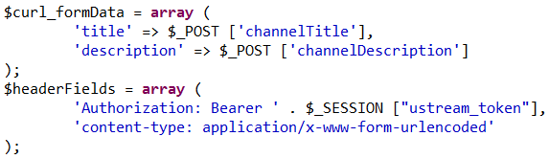
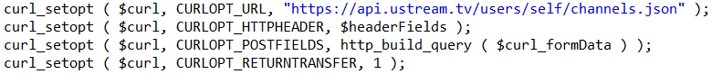
Channel Creation
The API request to create a channel is a straightforward process
Provide form input for channel title and description
Create new PHP script to post form fields to api site
And then call as usual

Slide 66
Lab 3 Overview
That covers channel create, let’s do the lab
Creating Channels
Lab 3: Channel Create
File Upload to Channel

Slide 67
Video Uploading
Lab 3: Channel Create
File Upload to Channel
Lab 4: Channel Upload

Slide 68
Video Upload Overview
The uploading of files is a multi-step process
Connect to Streaming Manager site for connection details
FTP file to channel in account
Set new video to a ready state so transcoding can start
These three steps hide a certain level of complexity
The web server will have limits on the size of POST data and file sizes
The web server will also have memory limits and various timeout settings
Default web server limits will need to be adjusted and the script must check those limits
Various error codes must be handled for FTP connections
After uploading, video must be set to a ready state for initiating transcode, or the video will never be listed in the channel

Slide 69
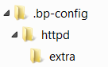
Potential Server Limits - Apache
Because this workshop is running in a Bluemix app some of these limits might be different than on a standalone server
Plus, the solution might be different
First adjustment is to the Apache web server’s proxy timeout which must be increased to keep the script alive while files are moved
For this solution a new folder is created in the project structure:
In this folder is a copy of the original httpd-php.conf file with an updated attribute
ProxySet disablereuse=On retry=0 timeout=1800

Slide 70
Potential Server Limits - PHP
The PHP configuration in the web server has the most modifications
A new file will be created at the top of the project: “.user.ini”
This file contains copies of attributes that will be overridden in the default “php.ini” file
upload_max_filesize=100M
post_max_size=100M
memory_limit=120M
max_execution_time=120
max_input_time=360
default_socket_timeout=360
Because this application is on Bluemix it is rebuilt for each code change, so any server changes are not persisted
In a standalone environment, these changes could be set on the server directly

Slide 71
File Upload UI Changes
The application web page will require new design elements
Input selection field for the channel ids
A file input element that allows multiple selections
Text input elements for video title and description
An output element to display results of the upload operation
Two notes:
The “name” of the file element is used in the PHP script
PHP code can be placed inline to show results from the upload script

Slide 72
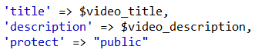
Upload Script – Step 1, The Connection Request
As noted in the overview, the first step is to acquire connection details for the upload request
This request needs four basic pieces of information
First, the channel id from the POST fields
Second, a query parameter for the connection type
Third, the usual header parameters
And last, optional form parameters

Slide 73
Upload Script – Step 1, Connection Response
The connection response provides the URL needed to actually make an FTP connection to the server and the id needed to make the video ready (not all returned parameters are shown)
Video id, used after uploading to set the ready state of the video
user id
password
channel id
path

Slide 74
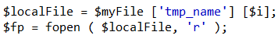
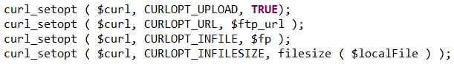
Upload Script – Step 2, FTP Upload Request
The FTP request needs the URL from the previous request and some other information from the POST’d file
First, the URL path needs the file extension appended, like ‘mp3’ or ‘mov’
It also needs a file descriptor for the local copy of the file
The completed set of FTP parameters

Slide 75
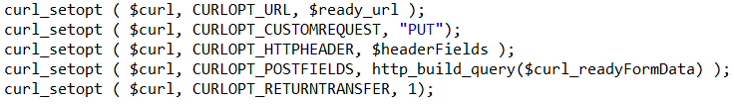
Upload Script – Step 3, Video Ready State Request
After the upload completes the video file is in a pending state, it has to be transcoded before it is available for publishing
In order to start the transcoding process the video must be set to ‘ready’ in the form fields
The URL will use the returned video id in its path
The completed set of PUT parameters, with the usual headers

Slide 76
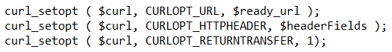

Upload Script – Step 4, Status Request
This step is optional but provides confirmation to the user
The same URL that set the ready state can be used in a GET request
Initially the state will be “transferred”, sent back to the home page in a session variable

Slide 77
Lab Overview
Lab 4:
Update home page with file selection elements
Create new PHP script to upload video file(s) and report results back to home page
File Upload to Channel
Lab 4: Channel Upload
Changing Accounts

Slide 78
Changing Accounts
Lab 4: Channel Upload
Changing Accounts
Lab 5: OAuth Account Change

Slide 79
Change Account Access with OAuth2
By default the initial account view is dependent on client credentials that exist in the account
What if there is a corporate landing page where account holders can view their content?
The workshop will implement an Authorization Flow to allow a user to log in and manage their own content
Authorization endpoint
Token endpoint
Login with IBM Cloud Video name and password
2. Redirect to call
token endpoint
2. Return access token
1. Link auth endpoint
1. Link auth endpoint
3. Return access token
1. Call token endpoint
2. Return access token
Implicit flow
Authorization flow
Client Credentials flow

Slide 80

Flow Mechanics
The Authorization Flow that will be implemented has a number of parts in the flow sequence
Let’s start with the URL on the home page:
href="https://www.ustream.tv/oauth2/authorize?response_type=code&client_id=1c24beffd05bf89a46bca3cf164d3cda1d4101d9&redirect_uri=https://geo-videodemo-php-1955.mybluemix.net/get_access_token&device_name=D200&scope=offline+broadcaster&state=WWBP"
The client_id and redirect_uri are both part of the credentials definition in the account
The redirect_uri specified in the authorization URL must match what’s defined in the account.

Slide 81

Implementation Basics
Additions will be made to the project to support the OAuth topology
A new folder is created at the top of the project matching the name of the redirect URI
A new home page is created as the landing location
A PHP script will be created to use the returned authentication code to acquire an access token
Authorization endpoint
Token endpoint
2. Redirect to call
token endpoint
./get_access_token/getAuthToken.php
./get_access_token/index.php
1. Link auth endpoint
3. Return access token
./index.php
Notes:
Main application page has a link to the token request site. Credentials are provided and an authorization token is generated. Control is passed to the redirect URL included in the link.
The redirect page in the application receives the authorization token in the query parameters. It is extracted and a request is made to the token request site for an access token.
The redirect page’s PHP script saves the new access token in session data and passes control back to the main page.

Slide 82

Authentication Token Landing Page
The new landing page is a minimal HTML page (./get_access_token/index.php)
PHP Token script loaded and executed in HTML header

Slide 83

Token Script Overview
The PHP script has 3 basic tasks (./get_access_token/getAuthToken.php):
Extract the authentication code from the query parameters returned by the OAuth redirect
Make a call to the token generator site to acquire a new authorization token
Save the new token for access on the main page
1
2
3
Notes:
In the first command, the $queryParm variable captures the output from the parse_str() method.
The query string has a ‘code’ field that contains the authorization code.
The redirect uri has to be maintained, minus any query parameters. Or, you could hardcode it since this is all part of the same application.

Slide 84



Main Script Modifications
The original PHP script used a fixed client key as an authentication token to use when acquiring an access token
If there was an OAuth redirect, the script may now have an access token already available
https://my-php-app.net
https://my-php-app.net/get_access_token
Default account
New OAuth account

Slide 85
Lab Overview
Lab 5:
Create a new transition web page to process the OAuth redirection
Create new PHP script to store the new access token
Update the main page to retrieve OAuth access token if it exists
Update the primary PHP script to utilize OAuth token if it exists
Use test credentials apitest@ustream.tv / Apitest1234
Changing Accounts
Lab 5: OAuth Account Change

Slide 86
OAuth Overview

Slide 87



What is OAuth
What is OAUTH?
An authorization protocol
Enables third party to obtain limited access on behalf of the resource owner
Allows third party application to obtain access on its own behalf.
Authorization Flows
Authorization Code
Implicit Grant
Resource Owner Password Credentials
Client Credentials
Authorization Server
Roles
Resource Owner
Resource Server
Authorization Server
OAUTH Client
User Directory
Authenticates users
Issues, authorizes, and manages oauth tokens
Resource Server
Resource Owner
OAuth Clients
Resource Server
Server hosting protected resources
Uses OAuth access tokens to provide access.
Browser
(User Agent)
Web Application
Native App
(Installed App/ Devices)

Slide 88
OAuth Terminology
Resource - The information or object of interest.
Resource Owner - The entity that maintains ownership of the resource.
Client - The entity requesting access to the resource. Clients must register with the Authorization Server prior to requesting resources.
Resource Server - Where the resource resides.
Authorization Server - Where the Resource Owners authenticate to allow or deny access to the resources. The Resource Owners never have to share their credentials with the client. Also where Clients authenticate to obtain an Access Token for the resource.
Authorization Code - A short-lived token provided directly to the Client by the Authorization Server. Implies that the client has permission to access the resource on the resource owner’s behalf. Used to obtain an Access Token.
Access Token - Used by the client to access protected resources. Contains information that defines the scope and duration of access which is enforced by the Resource Server.

Slide 89
OAuth Grant Types
Authorization Code Grant
The Authorization Code grant type is the most common OAuth2.0 flow. It implements 3-Legged OAuth and involves the user granting the client an authorization code, which can be exchanged for an Access Token.
Implicit Grant
Similar to the Authorization code grant described previously, however the user will be redirected in a browser to the authorization server, sign in, authorize the request but instead of being returned to the client with an authentication code they are redirected with an access token straight away. Care needs to be taken as the access token is more freely available in then style of interaction.
Resource Owner Password Credential Grant
The client itself will ask the user for their username and password (as opposed to being redirected to the authorization server to authenticate). The client will send the user credentials to the authorization server along with the client’s own credentials. If the authentication is successful then the client will be issued with an access token. This method is often used for trusted clients, such as Google’s own mobile app.
Client Credentials Grant
This grant is similar to the resource owner credentials grant except only the client’s credentials are used to authenticate a request for an access token. This grant should only be allowed to be used by trusted clients. It is a common grant type for machine-to-machine authentication.

Slide 90
OAuth flow
Authorization Code
Types of Tokens
Authorization Code – Token provided by Authorization server to resource owner
Access Token – short lived token (3600 s) exchanged for authorization code or refresh token.
Refresh Token – Token used to get new Access Token.
Revoke Token – Token used to invalidate access tokens.
Authorization Server
4
User Directory
7
Resource Server
Resource Owner
3
9
1
Authorization Code Flow
Request for protected resource
Redirection to Authorization server
Request for Authorization Code
Redirection to redirect URL with authorization code
Request to redirection URL with authorization code
Request for access token with authorization code
Response with Access token
Request with access token to Resource Server
Response from Resource Server
Response to client
5
6
2
8
10
Browser
(User Agent)
Web Application
(Confidential Client)
Native App
(Installed App/ Devices)
OAuth Clients

Slide 91


Slide 92
Resource Links
PHP Curl:
http://php.net/manual/en/book.curl.php
http://php.net/manual/en/curl.examples.php
http://www.web-development-blog.com/archives/tutorial-ftp-upload-via-curl/
https://www.ustream.tv/recorded/46730533#itm_source=mkto&itm_medium=email&itm_content=embed&itm_campaign=ft_drip-e4
http://developers.ustream.tv/broadcasting-api/php-sample-code.html
http://developers.ustream.tv/broadcasting-api/getting-started.html
http://developers.ustream.tv/broadcasting-api/channel.html

